Slide 1


Welcome to
TechConnect Cloud Live Online Training

Slide 2


What is TechConnect Cloud?
TechConnect Cloud is the educational media distribution source for video and
audio content, streaming services and event coverage offering services to CCCCO
system faculty and staff.
CCC TechConnect is funded by the CCCCO and is housed at Palomar College.
Our project umbrella is CCC TechConnect, which includes…
TechConnect (3C Media Solutions, CCC Confer, Online Teaching Conference)
Grant-funded by the California Community Colleges Chancellor’s Office | Hosted by Palomar College
3C Media Solutions, CCC Confer, Online Teaching Conference
Grant-funded by the California Community Colleges Chancellor’s Office | Hosted by Palomar College

Slide 3
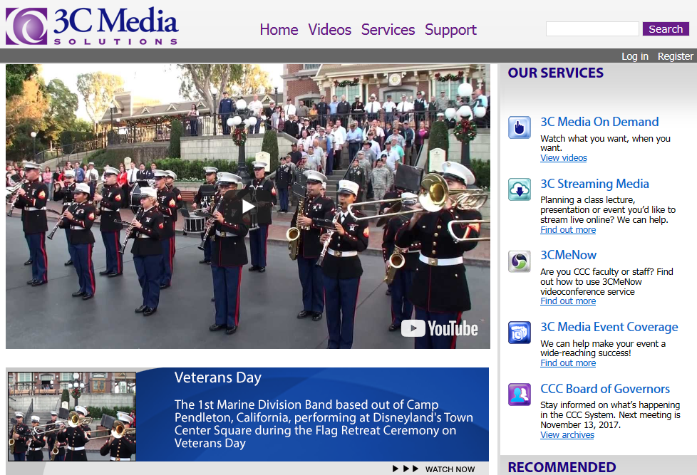
Register for an Account
www.3cmediasolutions.org
TechConnect (3C Media Solutions, CCC Confer, Online Teaching Conference)
Grant-funded by the California Community Colleges Chancellor’s Office | Hosted by Palomar College
3C Media Solutions, CCC Confer, Online Teaching Conference
Grant-funded by the California Community Colleges Chancellor’s Office | Hosted by Palomar College

Slide 4
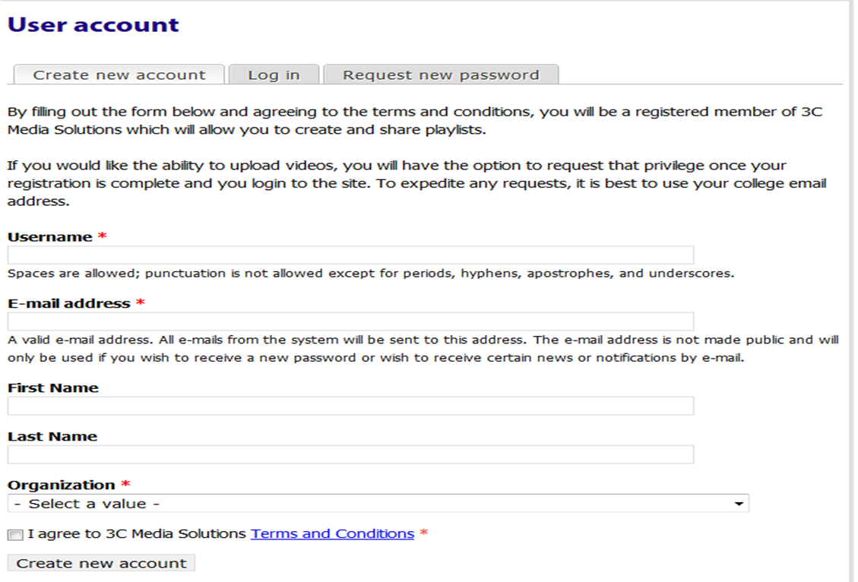
Sign Up
Provide your information & click Create new account button. Once
a confirmation from us is received you can log in to your new account.
TechConnect (3C Media Solutions, CCC Confer, Online Teaching Conference)
Grant-funded by the California Community Colleges Chancellor’s Office | Hosted by Palomar College
3C Media Solutions, CCC Confer, Online Teaching Conference
Grant-funded by the California Community Colleges Chancellor’s Office | Hosted by Palomar College

Slide 5
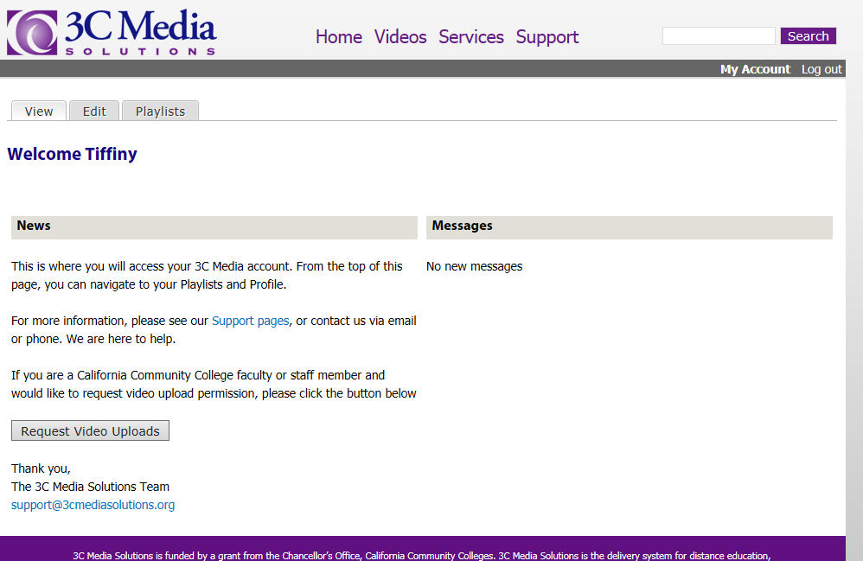
Request Video Upload Rights
Faculty and Staff must request rights to upload videos and files.
TechConnect (3C Media Solutions, CCC Confer, Online Teaching Conference)
Grant-funded by the California Community Colleges Chancellor’s Office | Hosted by Palomar College
3C Media Solutions, CCC Confer, Online Teaching Conference
Grant-funded by the California Community Colleges Chancellor’s Office | Hosted by Palomar College

Slide 6
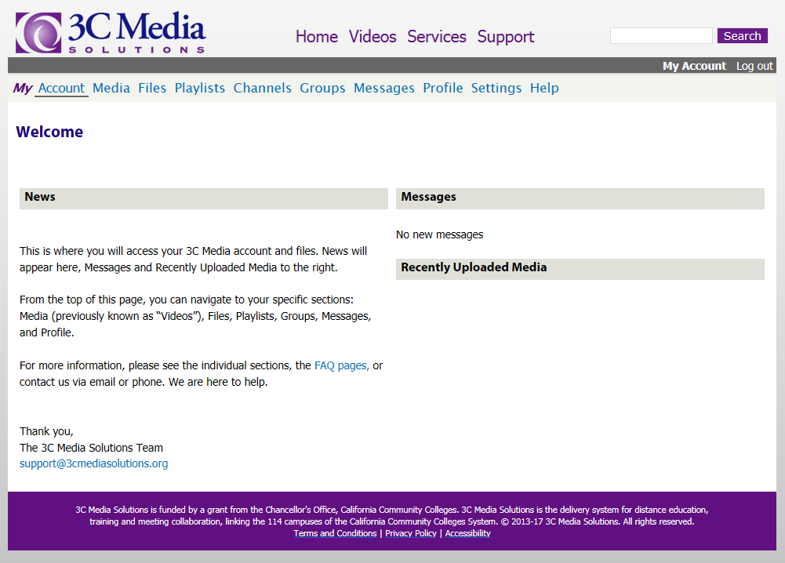
Upload and Store Videos
TechConnect (3C Media Solutions, CCC Confer, Online Teaching Conference)
Grant-funded by the California Community Colleges Chancellor’s Office | Hosted by Palomar College
3C Media Solutions, CCC Confer, Online Teaching Conference
Grant-funded by the California Community Colleges Chancellor’s Office | Hosted by Palomar College

Slide 7
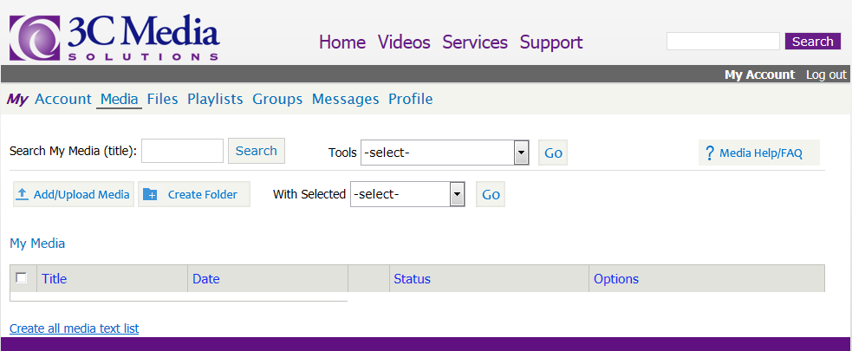
My Videos
This is what your Media page will look like when you first access your account.
To add media, click on the “Add/Upload Media” button.
TechConnect (3C Media Solutions, CCC Confer, Online Teaching Conference)
Grant-funded by the California Community Colleges Chancellor’s Office | Hosted by Palomar College
3C Media Solutions, CCC Confer, Online Teaching Conference
Grant-funded by the California Community Colleges Chancellor’s Office | Hosted by Palomar College

Slide 8
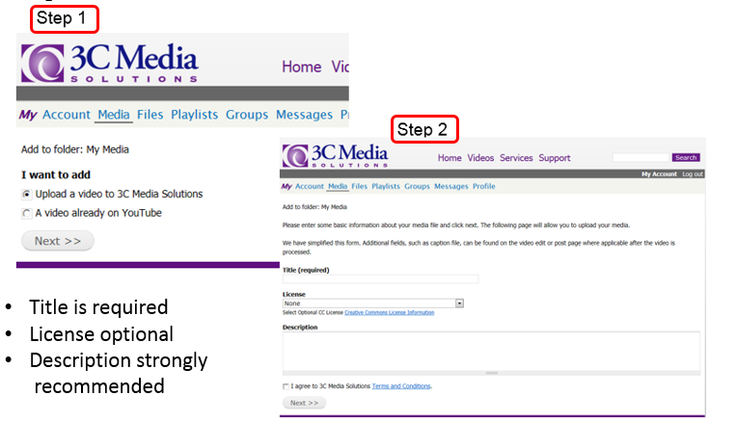
Upload a Video…
TechConnect (3C Media Solutions, CCC Confer, Online Teaching Conference)
Grant-funded by the California Community Colleges Chancellor’s Office | Hosted by Palomar College
3C Media Solutions, CCC Confer, Online Teaching Conference
Grant-funded by the California Community Colleges Chancellor’s Office | Hosted by Palomar College

Slide 9
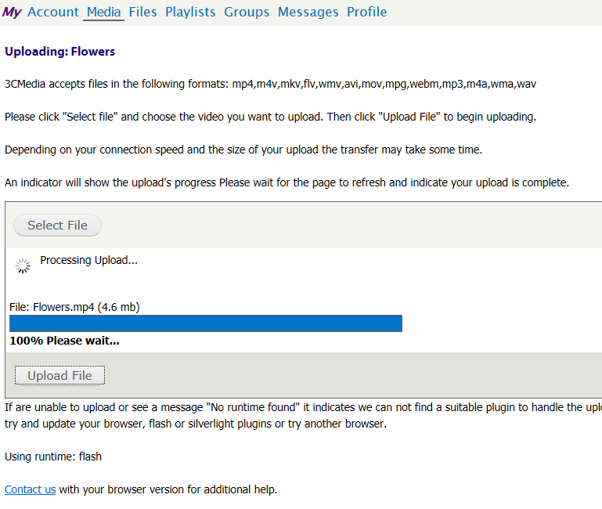
Upload a Video…
Step 3
1GB upload limit
per video
Please wait until
the progress bar
is at 100%
Then, go back to
Media & refresh
your page
TechConnect (3C Media Solutions, CCC Confer, Online Teaching Conference)
Grant-funded by the California Community Colleges Chancellor’s Office | Hosted by Palomar College
3C Media Solutions, CCC Confer, Online Teaching Conference
Grant-funded by the California Community Colleges Chancellor’s Office | Hosted by Palomar College

Slide 10
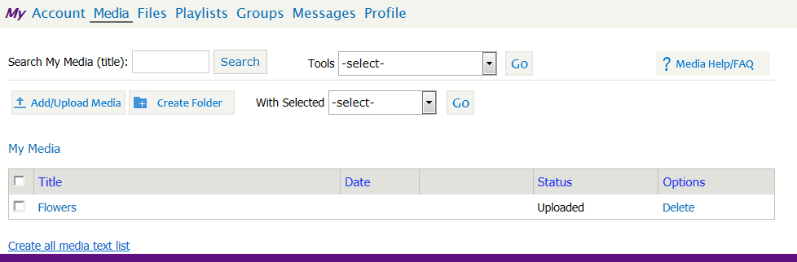
Upload a Video
While your file is being processed, you will see under the “status” column that
the file is marked “Uploaded”.
Depending on the size, it could take a few minutes to become “Available”, meaning
that the file is ready for you to work with.
TechConnect (3C Media Solutions, CCC Confer, Online Teaching Conference)
Grant-funded by the California Community Colleges Chancellor’s Office | Hosted by Palomar College
3C Media Solutions, CCC Confer, Online Teaching Conference
Grant-funded by the California Community Colleges Chancellor’s Office | Hosted by Palomar College

Slide 11

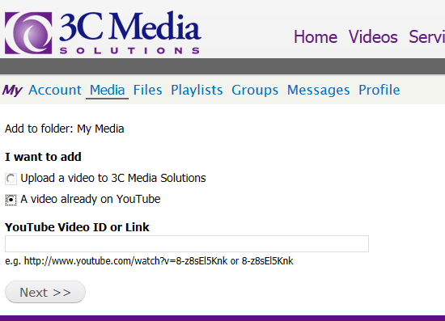
Add a Video from YouTube…
Step 1
Step 2
TechConnect (3C Media Solutions, CCC Confer, Online Teaching Conference)
Grant-funded by the California Community Colleges Chancellor’s Office | Hosted by Palomar College
3C Media Solutions, CCC Confer, Online Teaching Conference
Grant-funded by the California Community Colleges Chancellor’s Office | Hosted by Palomar College

Slide 12
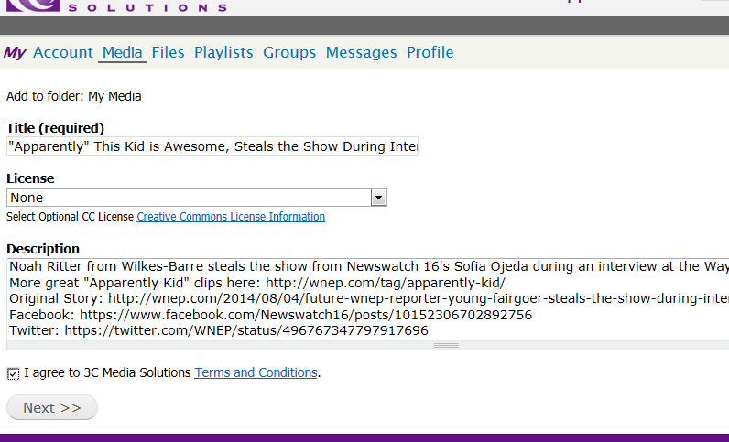
Add a Video from YouTube…
Step 3
TechConnect (3C Media Solutions, CCC Confer, Online Teaching Conference)
Grant-funded by the California Community Colleges Chancellor’s Office | Hosted by Palomar College
3C Media Solutions, CCC Confer, Online Teaching Conference
Grant-funded by the California Community Colleges Chancellor’s Office | Hosted by Palomar College

Slide 13
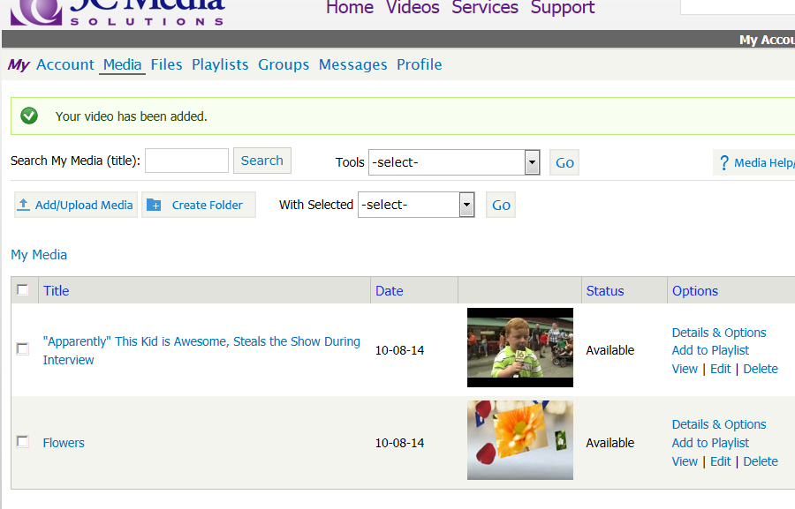

Add a Video from YouTube
Complete
Remember:
All videos
uploaded, by
default, are
“protected”
TechConnect (3C Media Solutions, CCC Confer, Online Teaching Conference)
Grant-funded by the California Community Colleges Chancellor’s Office | Hosted by Palomar College
3C Media Solutions, CCC Confer, Online Teaching Conference
Grant-funded by the California Community Colleges Chancellor’s Office | Hosted by Palomar College

Slide 14
Details & Options…
TechConnect (3C Media Solutions, CCC Confer, Online Teaching Conference)
Grant-funded by the California Community Colleges Chancellor’s Office | Hosted by Palomar College
3C Media Solutions, CCC Confer, Online Teaching Conference
Grant-funded by the California Community Colleges Chancellor’s Office | Hosted by Palomar College

Slide 15
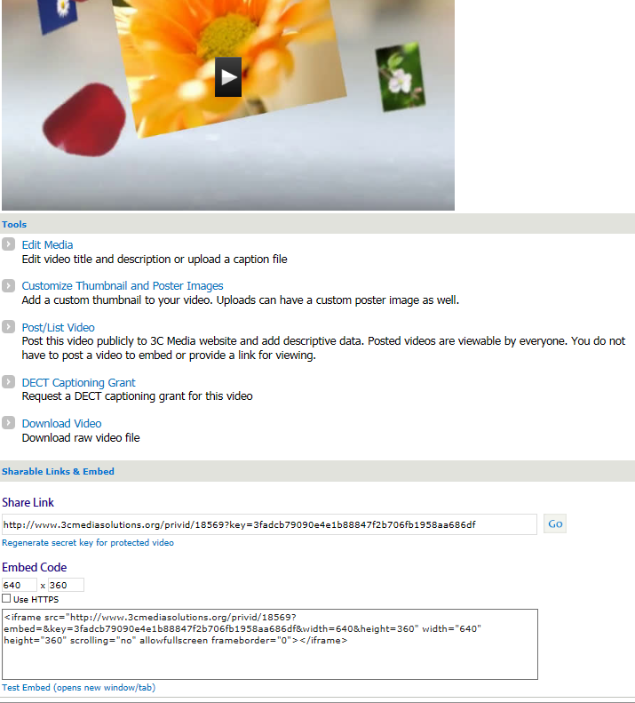
Details & Options
TechConnect (3C Media Solutions, CCC Confer, Online Teaching Conference)
Grant-funded by the California Community Colleges Chancellor’s Office | Hosted by Palomar College
3C Media Solutions, CCC Confer, Online Teaching Conference
Grant-funded by the California Community Colleges Chancellor’s Office | Hosted by Palomar College

Slide 16
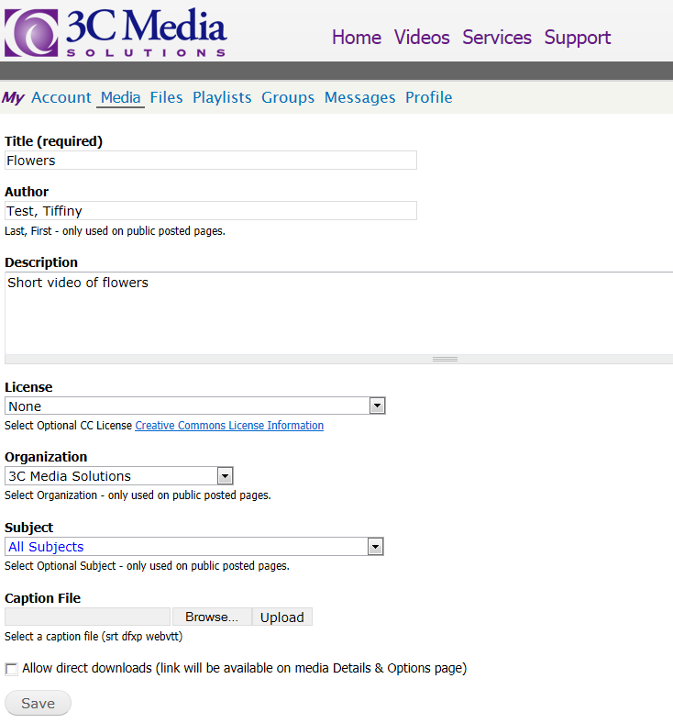
Edit Media
From this page you can:
Change title
Change author
Add/change description
Add license
Add caption file
(vtt file)
TechConnect (3C Media Solutions, CCC Confer, Online Teaching Conference)
Grant-funded by the California Community Colleges Chancellor’s Office | Hosted by Palomar College
3C Media Solutions, CCC Confer, Online Teaching Conference
Grant-funded by the California Community Colleges Chancellor’s Office | Hosted by Palomar College

Slide 17
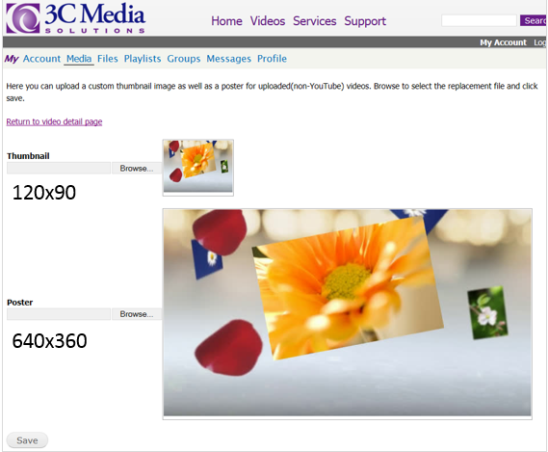
Customize Thumbnail & Poster Images
Images need to be the size noted or smaller
TechConnect (3C Media Solutions, CCC Confer, Online Teaching Conference)
Grant-funded by the California Community Colleges Chancellor’s Office | Hosted by Palomar College
3C Media Solutions, CCC Confer, Online Teaching Conference
Grant-funded by the California Community Colleges Chancellor’s Office | Hosted by Palomar College

Slide 18
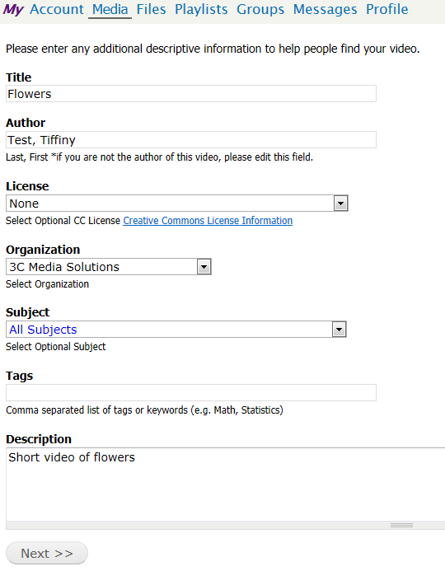
Post/List Video
TechConnect (3C Media Solutions, CCC Confer, Online Teaching Conference)
Grant-funded by the California Community Colleges Chancellor’s Office | Hosted by Palomar College
3C Media Solutions, CCC Confer, Online Teaching Conference
Grant-funded by the California Community Colleges Chancellor’s Office | Hosted by Palomar College

Slide 19
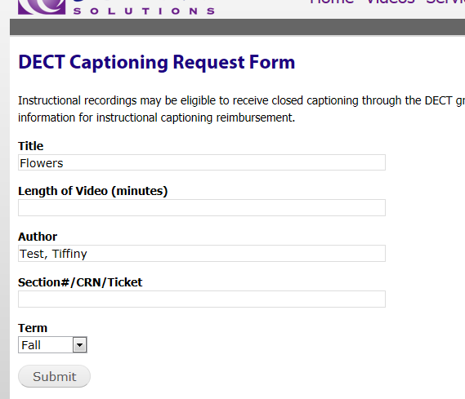
Request Captioning
Submit form
Caption files will usually be automatically added to your video within 4-6 business days
Captioning is not available for YouTube videos
Note: DECT Captioning Grant is intended for use for educational/instructional videos and will
need to be approved according to the DECT guidelines.
TechConnect (3C Media Solutions, CCC Confer, Online Teaching Conference)
Grant-funded by the California Community Colleges Chancellor’s Office | Hosted by Palomar College
3C Media Solutions, CCC Confer, Online Teaching Conference
Grant-funded by the California Community Colleges Chancellor’s Office | Hosted by Palomar College

Slide 20
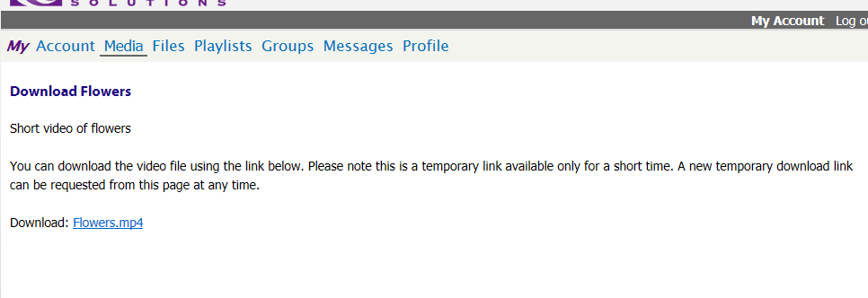
Download Video
Please note: A user will only see the download option if they have uploaded
videos that are not public. Videos such as YouTube files are public and cannot
be downloaded.
TechConnect (3C Media Solutions, CCC Confer, Online Teaching Conference)
Grant-funded by the California Community Colleges Chancellor’s Office | Hosted by Palomar College
3C Media Solutions, CCC Confer, Online Teaching Conference
Grant-funded by the California Community Colleges Chancellor’s Office | Hosted by Palomar College

Slide 21
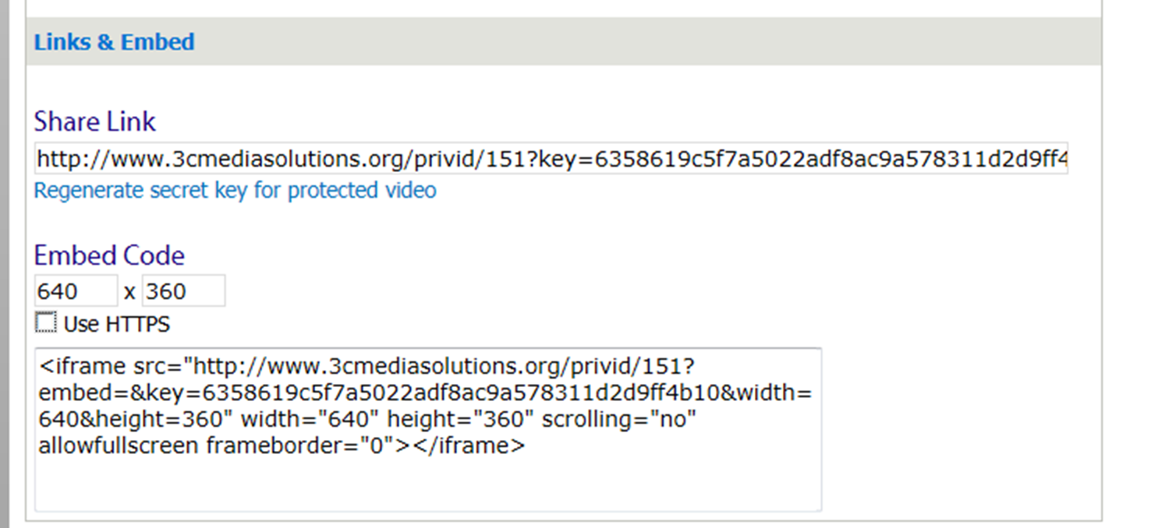

Links & Embed Code
Remember!
The video share link can be used indefinitely, or ‘regenerated’ at any time
TechConnect (3C Media Solutions, CCC Confer, Online Teaching Conference)
Grant-funded by the California Community Colleges Chancellor’s Office | Hosted by Palomar College
3C Media Solutions, CCC Confer, Online Teaching Conference
Grant-funded by the California Community Colleges Chancellor’s Office | Hosted by Palomar College

Slide 22
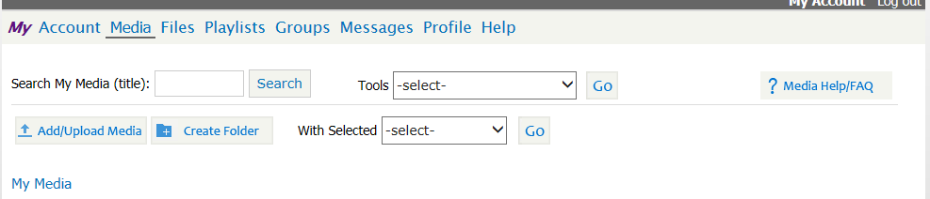
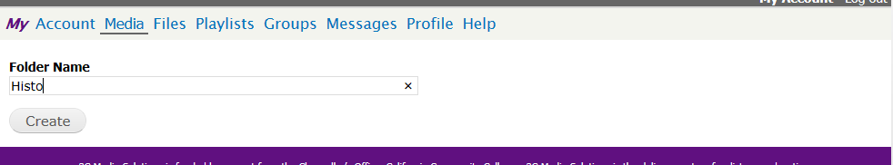
Folders – Creating…
Create a Folder
Name the Folder
TechConnect (3C Media Solutions, CCC Confer, Online Teaching Conference)
Grant-funded by the California Community Colleges Chancellor’s Office | Hosted by Palomar College
3C Media Solutions, CCC Confer, Online Teaching Conference
Grant-funded by the California Community Colleges Chancellor’s Office | Hosted by Palomar College

Slide 23
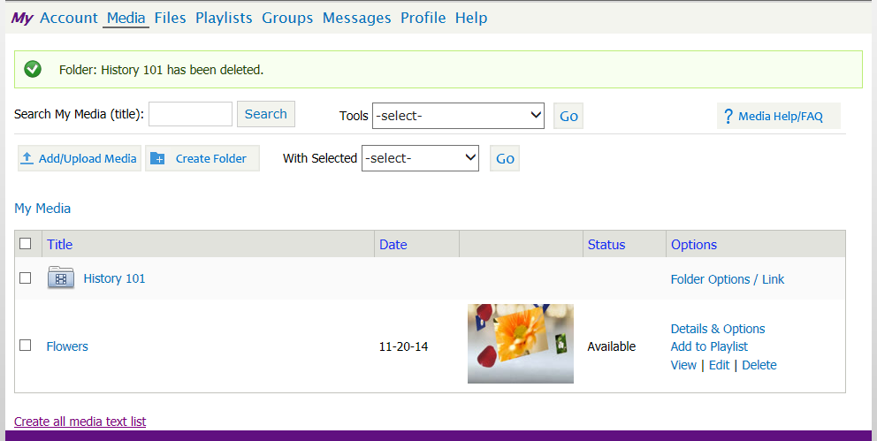
Folders - Creating
Keep your files organized by using folders
TechConnect (3C Media Solutions, CCC Confer, Online Teaching Conference)
Grant-funded by the California Community Colleges Chancellor’s Office | Hosted by Palomar College
3C Media Solutions, CCC Confer, Online Teaching Conference
Grant-funded by the California Community Colleges Chancellor’s Office | Hosted by Palomar College

Slide 24
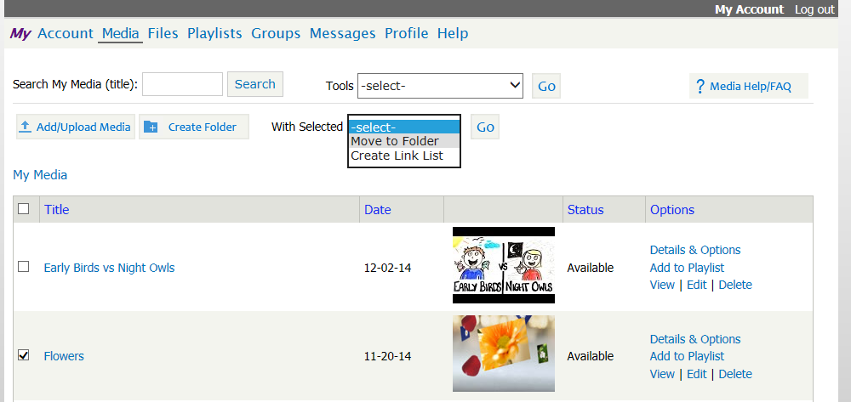
Folders – Moving…
Move files into folders quickly and easily.
2
1
Select video from Media list
Click the “with selected” drop down menu
Click “Move to Folder” and “Go”.
When prompted, choose the folder you want to move the video into
TechConnect (3C Media Solutions, CCC Confer, Online Teaching Conference)
Grant-funded by the California Community Colleges Chancellor’s Office | Hosted by Palomar College
3C Media Solutions, CCC Confer, Online Teaching Conference
Grant-funded by the California Community Colleges Chancellor’s Office | Hosted by Palomar College

Slide 25
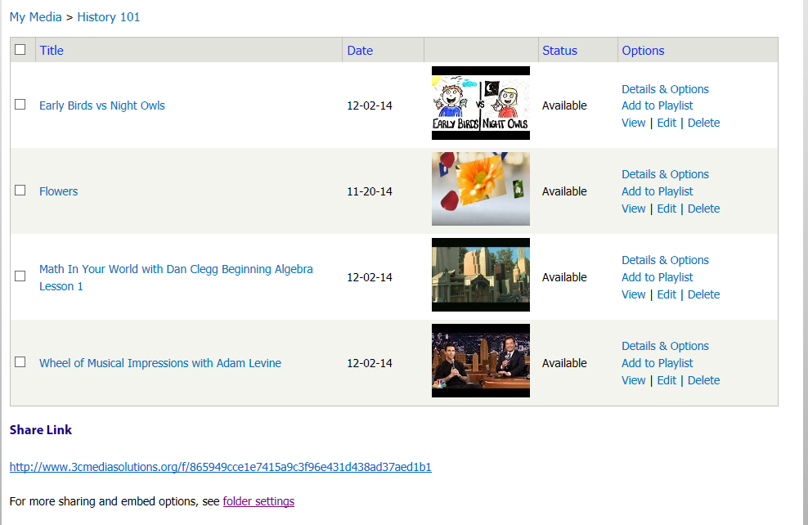
Folders
Add as many videos as you’d like to a folder – Share link to all.
TechConnect (3C Media Solutions, CCC Confer, Online Teaching Conference)
Grant-funded by the California Community Colleges Chancellor’s Office | Hosted by Palomar College
3C Media Solutions, CCC Confer, Online Teaching Conference
Grant-funded by the California Community Colleges Chancellor’s Office | Hosted by Palomar College

Slide 26
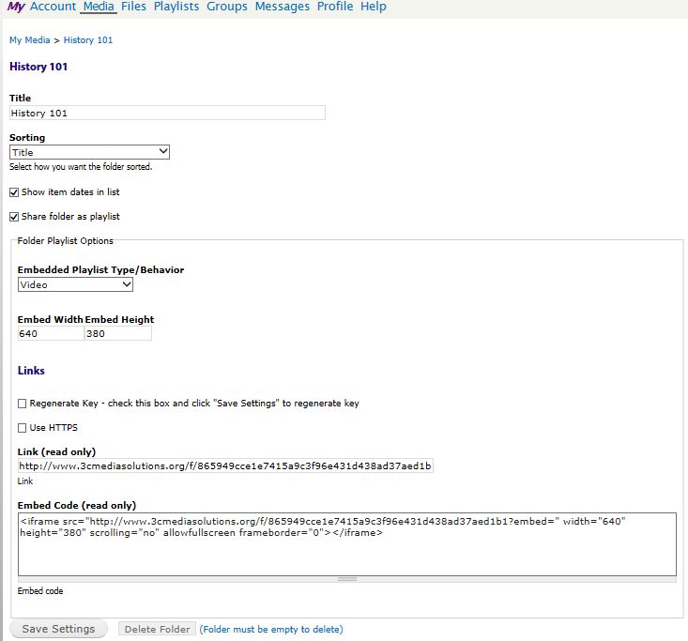
Folder Options
Folders can be
sorted by title,
date added, or
customized.
Dates can either
be listed or hidden
Embed behavior and
size can be set
When shared as
a playlist, the link
and embed codes
are available.
TechConnect (3C Media Solutions, CCC Confer, Online Teaching Conference)
Grant-funded by the California Community Colleges Chancellor’s Office | Hosted by Palomar College
3C Media Solutions, CCC Confer, Online Teaching Conference
Grant-funded by the California Community Colleges Chancellor’s Office | Hosted by Palomar College

Slide 27
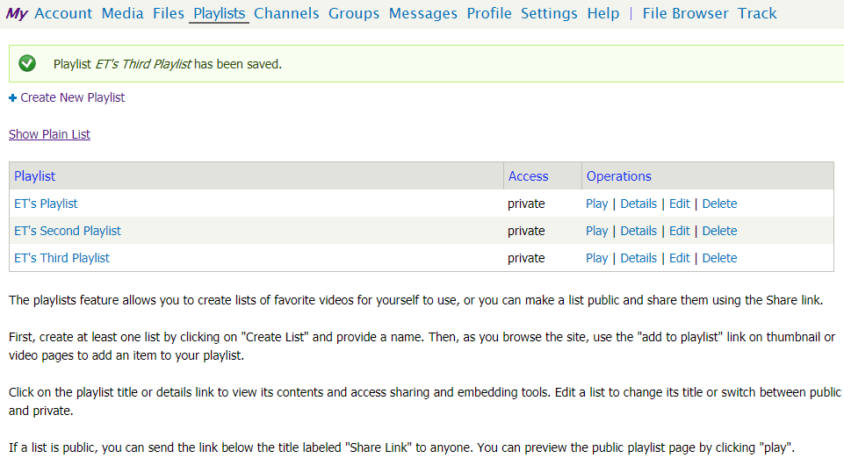
Playlists – Create
In your 3CMedia account, click Playlist then click on Create New Playlist and Name it and give Share Permissions and click Save button.
TechConnect (3C Media Solutions, CCC Confer, Online Teaching Conference)
Grant-funded by the California Community Colleges Chancellor’s Office | Hosted by Palomar College
3C Media Solutions, CCC Confer, Online Teaching Conference
Grant-funded by the California Community Colleges Chancellor’s Office | Hosted by Palomar College

Slide 28
My Files Repository…
What is it?
3C’s File repository is a place to store files other than video and audio.
Similarities to “My Media”:
Files are uploaded to 3C server from your local machine only
  Folders:
  Same sorting features (Title, Date, Custom)
  Share link for the entire folder
  Able to regenerate key
Important Differences:
  The file is not played in the browser but instead downloaded to the local machine to view.
  To view the file, a user must have software matching that of the file.
  Embedding is not supported.
TechConnect (3C Media Solutions, CCC Confer, Online Teaching Conference)
Grant-funded by the California Community Colleges Chancellor’s Office | Hosted by Palomar College
3C Media Solutions, CCC Confer, Online Teaching Conference
Grant-funded by the California Community Colleges Chancellor’s Office | Hosted by Palomar College

Slide 29
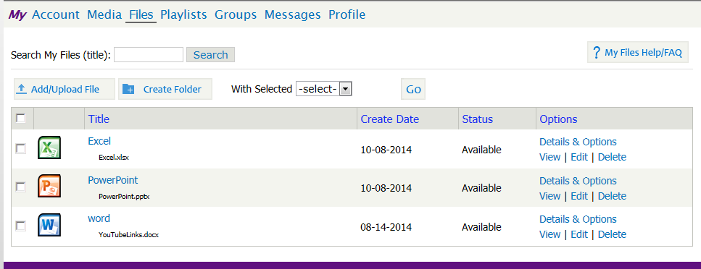
My Files Repository
    Files accepted include:
    .jpg, .gif, .png, .pdf, .bmp, .vi, .doc, .docx, .ppt, .pptx, .txt, .xls, .xlsx, .pm4, .mp4v, .mkv, .flv, .wmv, .avi, .mov, .mpg, .oog, .webm, .mp3, .wav, .m4a, .mpeg, .zip, .rar, .gz, .swf
TechConnect (3C Media Solutions, CCC Confer, Online Teaching Conference)
Grant-funded by the California Community Colleges Chancellor’s Office | Hosted by Palomar College
3C Media Solutions, CCC Confer, Online Teaching Conference
Grant-funded by the California Community Colleges Chancellor’s Office | Hosted by Palomar College

Slide 30
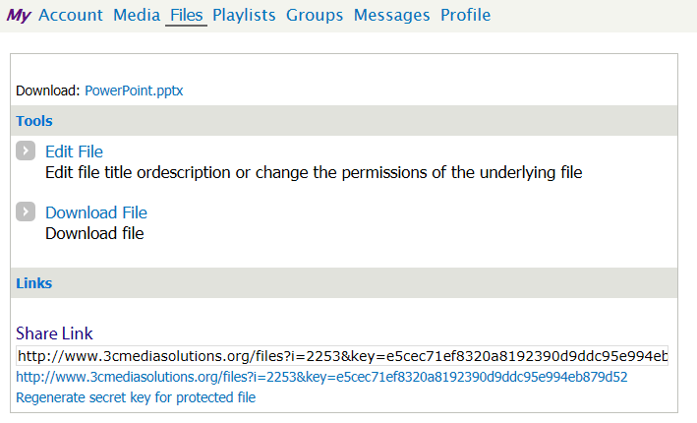
My Files Repository - Options
My Files can be shared with a link. Embedding is not supported.
TechConnect (3C Media Solutions, CCC Confer, Online Teaching Conference)
Grant-funded by the California Community Colleges Chancellor’s Office | Hosted by Palomar College
3C Media Solutions, CCC Confer, Online Teaching Conference
Grant-funded by the California Community Colleges Chancellor’s Office | Hosted by Palomar College

Slide 31
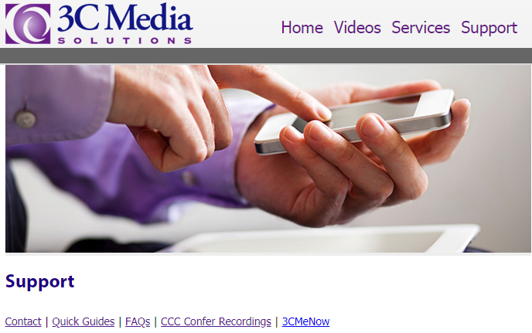
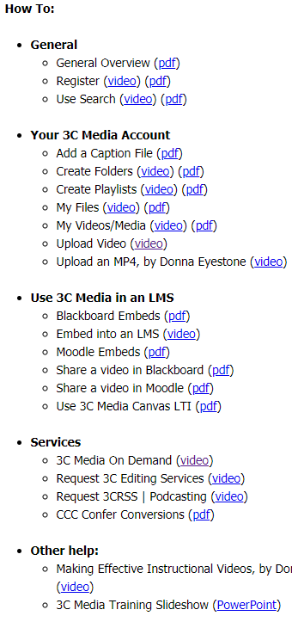
3C Media Website Support
1
3
2
www.3cmediasolutions.org
TechConnect (3C Media Solutions, CCC Confer, Online Teaching Conference)
Grant-funded by the California Community Colleges Chancellor’s Office | Hosted by Palomar College
3C Media Solutions, CCC Confer, Online Teaching Conference
Grant-funded by the California Community Colleges Chancellor’s Office | Hosted by Palomar College

Slide 32
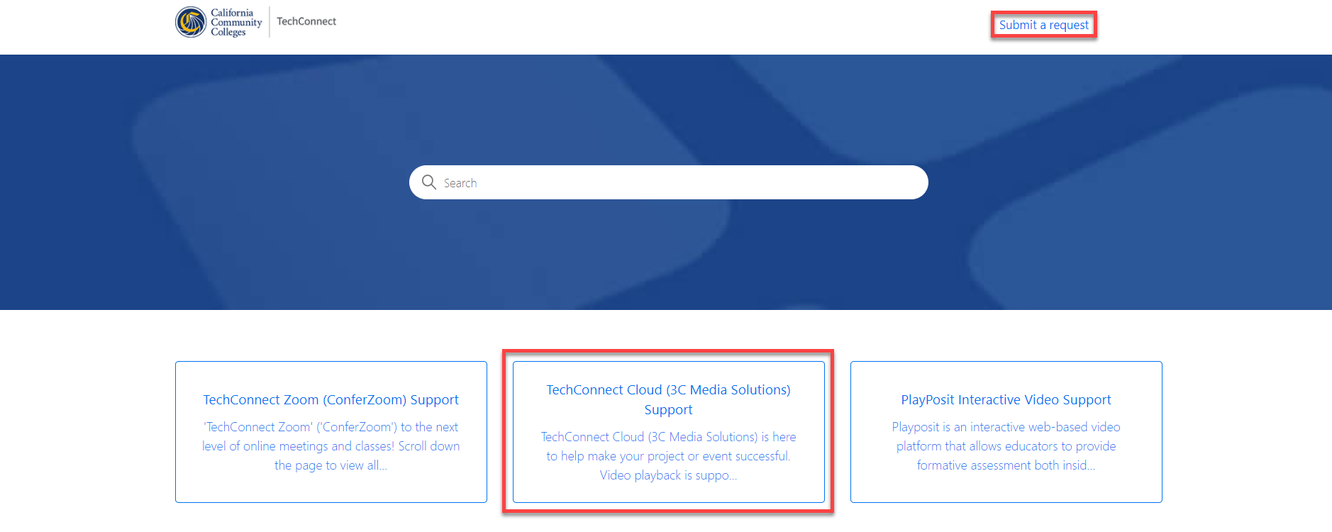
TechConnect Cloud Knowledge Base Support
https://ccctechconnect.zendesk.com
TechConnect (3C Media Solutions, CCC Confer, Online Teaching Conference)
Grant-funded by the California Community Colleges Chancellor’s Office | Hosted by Palomar College
3C Media Solutions, CCC Confer, Online Teaching Conference
Grant-funded by the California Community Colleges Chancellor’s Office | Hosted by Palomar College

Slide 33

TechConnect (3C Media Solutions, CCC Confer, Online Teaching Conference)
Grant-funded by the California Community Colleges Chancellor’s Office | Hosted by Palomar College
3C Media Solutions, CCC Confer, Online Teaching Conference
Grant-funded by the California Community Colleges Chancellor’s Office | Hosted by Palomar College

Slide 34
TechConnect Cloud
Same level of SUPPORT you know from CCC Confer
  - Email support contact
  - Website support documents
  - Training videos
  - Monthly Newsletters
  - Quarterly Updates
3C Media Solutions
365 S. Rancho Santa Fe Road, Suite 104
San Marcos, Ca. 92078
United States
Email: support@ccctechconnect.org
Website: www.3cmediasolutions.org
TechConnect (3C Media Solutions, CCC Confer, Online Teaching Conference)
Grant-funded by the California Community Colleges Chancellor’s Office | Hosted by Palomar College
3C Media Solutions, CCC Confer, Online Teaching Conference
Grant-funded by the California Community Colleges Chancellor’s Office | Hosted by Palomar College

